Slide 1
Introduction to Project
In order to determine classroom attendance, face detection and face recognition are performed. Face detection is used to determine the location of the faces in the classroom image and extract sub images for each face. Then, in face recognition, the face images detected will be compared with the data base consisting of images of students in the class, and attendance will be recorded accordingly

Slide 2

Problem Formulation
Traditionally attendance is marked manually by teachers and they must make sure correct attendance is marked for respective student.
This whole process wastes some of lecture time and part of correct information is missed due to fraudulent and proxy cases.

Slide 3
Objectives of the Work
The objective of the e - attendance software is to reduce the time that is consumed when attendance is taken manually. Unlike the manual process, an online system easily helps management to analyze student's attendance details as per requirement.

Slide 4
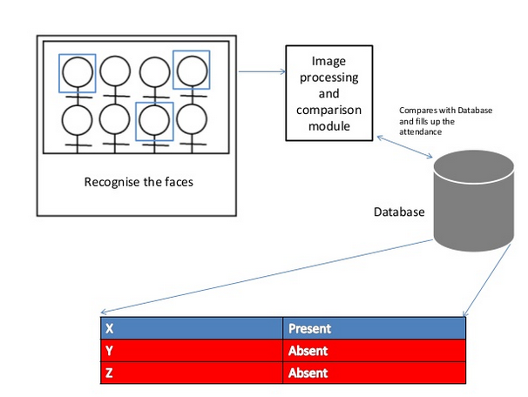
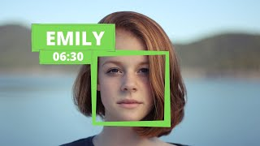
Methodology used

Slide 5

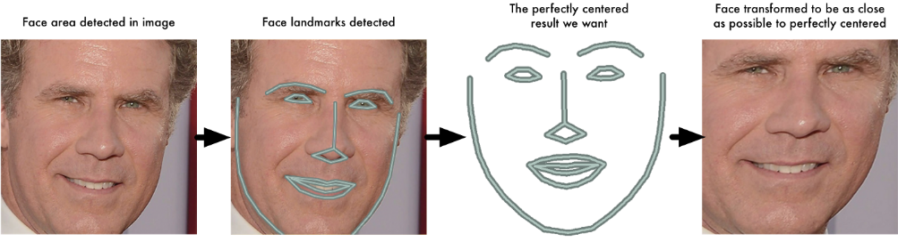
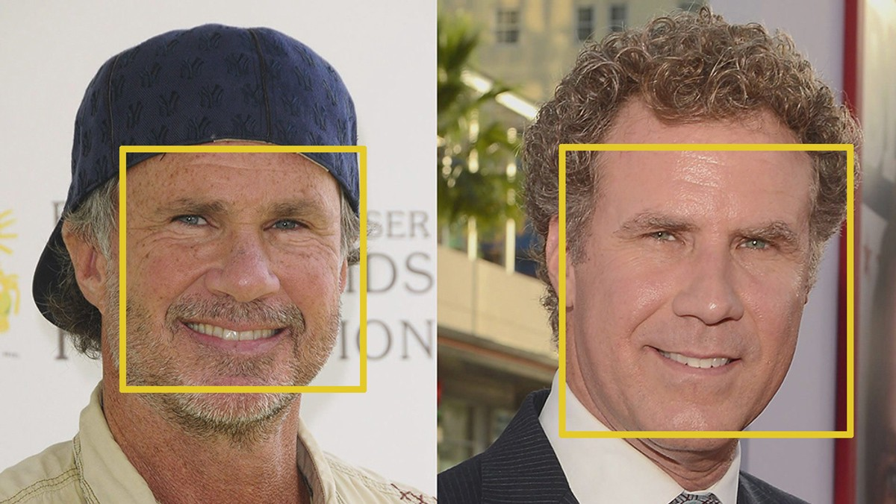
Results and Outputs
Our code using HOG to find faces and isolate them from the background
Then we use face landmark estimation. The basic idea is we will come up with 68 specific points (called landmarks) that exist on every face — the top of the chin, the outside edge of each eye, the inner edge of each eyebrow, etc. Then we will train a machine learning algorithm to be able to find these 68 points.
Next to recognize unknown faces from known faces we measure the distances of facial features using Deep CNN to generate 128 measurements of each known faces and then compare it with the known faces.
Next we use a simple SVM classifier algorithm to classify an unknown face to a known face to finally tell who the new image is of and mark the attendance in a .csv file.

Slide 6
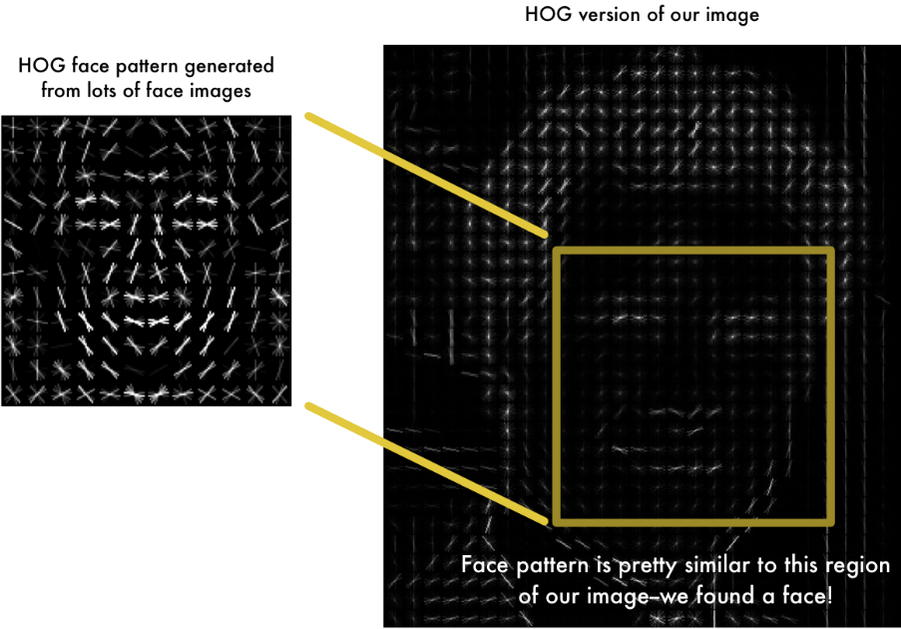

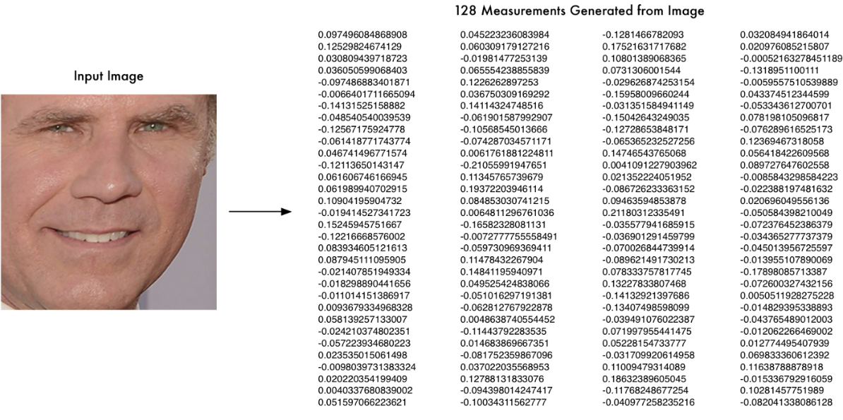
Python Results
By using a PYTHON code, We’re going to use a method invented in 2005 called Histogram of Oriented Gradients — or just HOG for short to find faces in an image.
The python code then uses facial landmark estimation along with deep CNN to generate 128 measurements
And then finally we use simple SVM classifier to recognize the person in the video

Slide 7
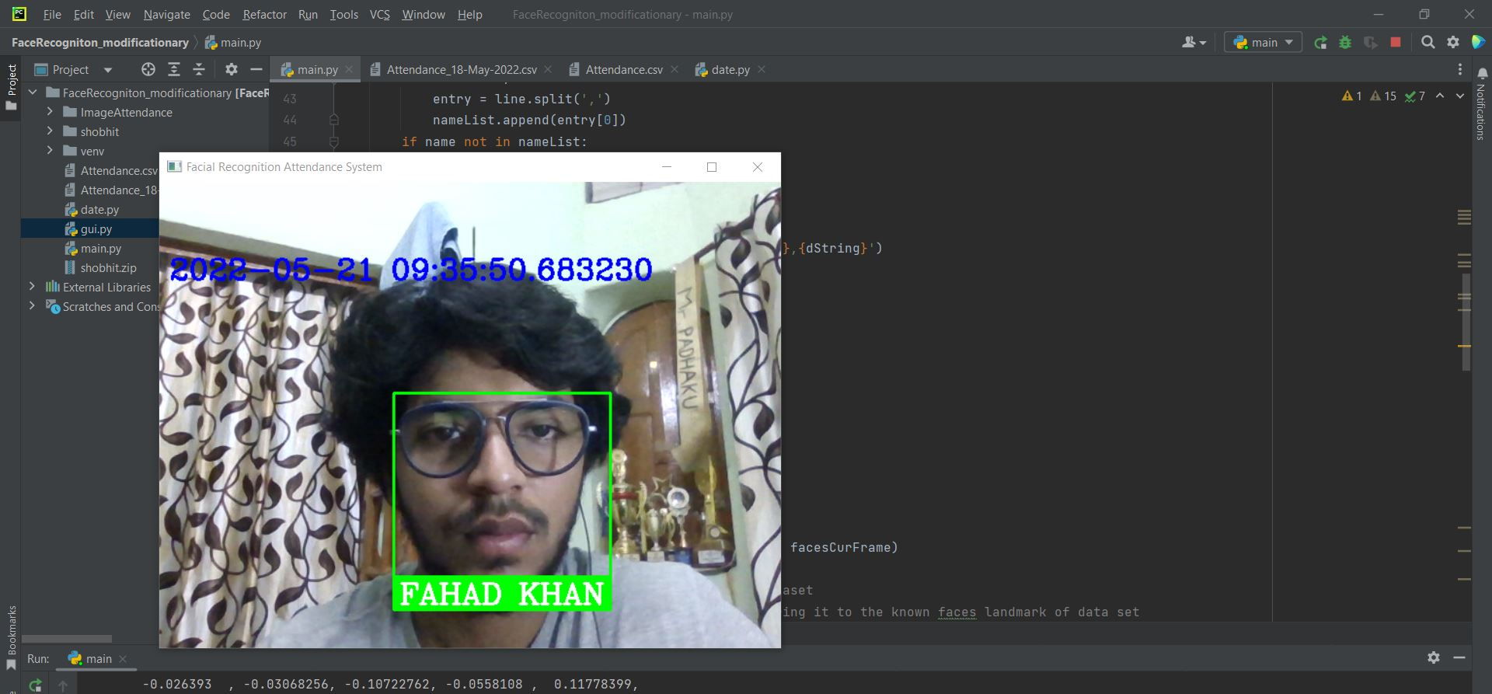
When we applied the openCV python code, the code was able to successfully recognize the faces, it detect the faces and write the names of recognized persons as shown:

Slide 8
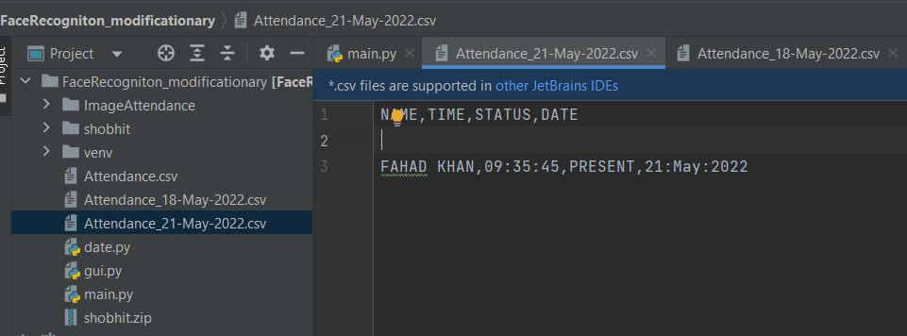
Then the code will creates a .csv file for present students as shown:

